Slide 1
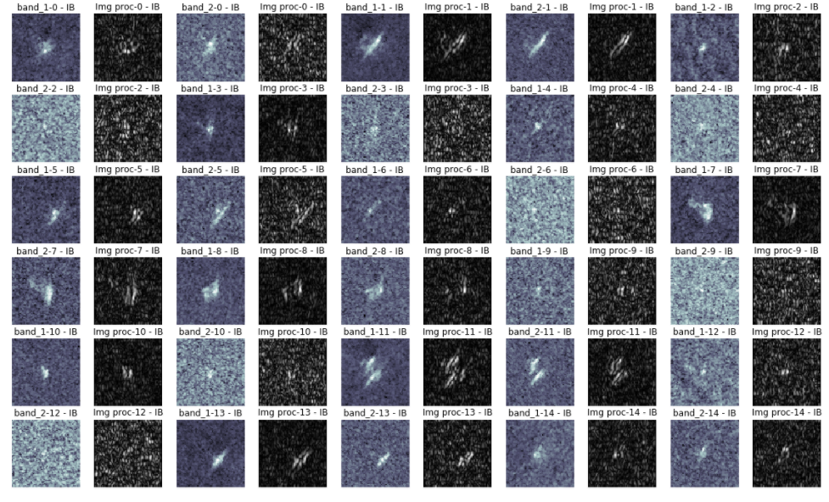
Gaussian blur + Sobelx

Slide 2
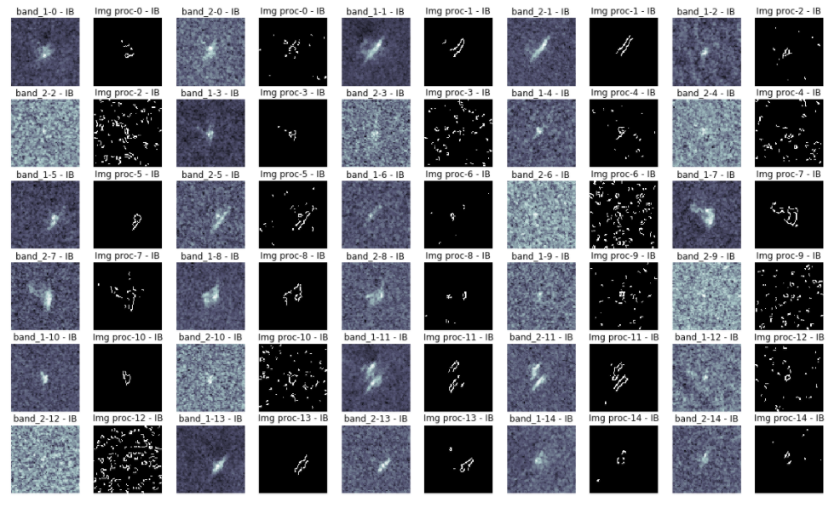
Gaussian blur + Edge canny

Slide 3
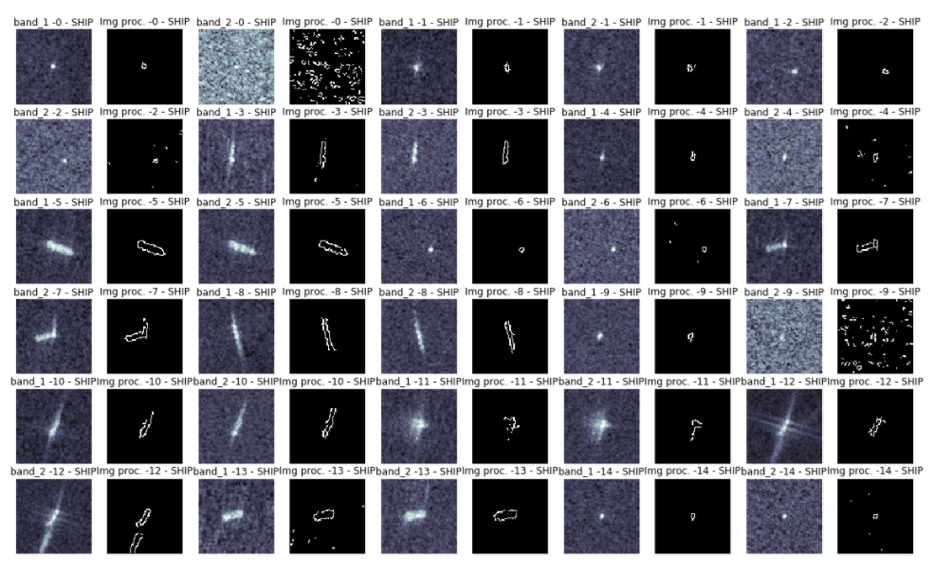
Gaussian blur + Edge canny

Slide 4
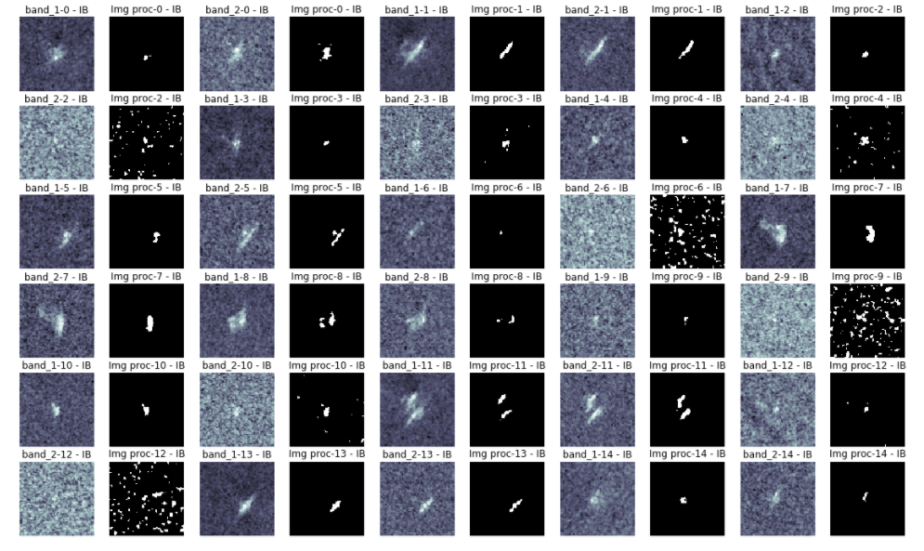
Gaussian blur + Threshold binary

Slide 5
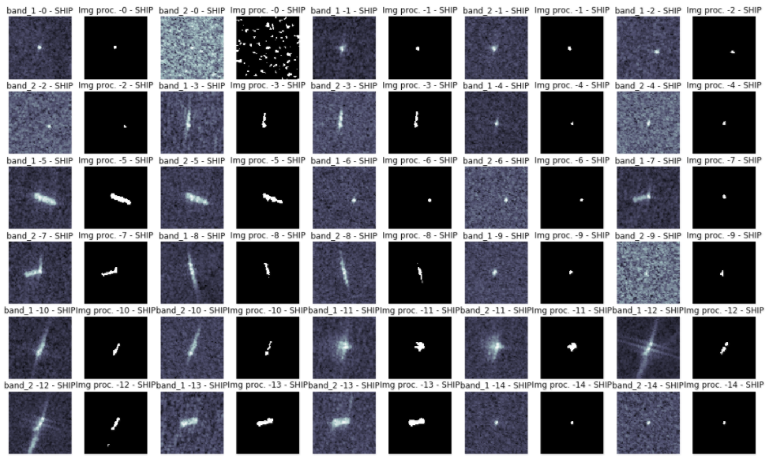
Gaussian blur + Threshold binary

